Slide 1

Human-Computer Interaction (HCI)
Mario Čagalj
University of Split
17.10.2012.

Slide 2
The Psychology of Everyday Actions
Based on slides by Saul Greenberg, Russell Beale, Tolga Can,
John Hall …

Slide 3
High-level vs. low-level models of human-computer behaviour
Developing Theories in HCI
  must explain and predict human behaviour in the human-computer system
  must work in a wide variety of task situations
  must work within broad spectrum of system designs and implementations
Low-level theories can be used to predict human performance
  Fitts’ law: time to select an item with a pointing device (this lecture)
  Keystroke level model: sums up times for keystroking, pointing, homing, drawing, thinking and waiting
  ...
General models that explain human behaviour with machines
  Shneiderman’s syntactic/semantic model
  Norman’s 7 stages of action (this lecture)
  all of psychology!

Slide 4
Low-level theories: the case of Fitts’ law

Slide 5
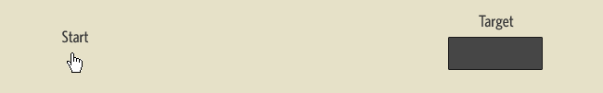
Fitts’ law
T= a + b log₂ (1+D/W), T-time, D-distance, W-width
  a model of human movement that predicts that the time required to rapidly move to a target area is a function of the distance to the target and the size of the target
  is used to model the act of pointing, either by physically touching an object with a hand or finger, or virtually, by pointing to an object on a computer monitor using a pointing device
  was proposed by Paul Fitts in 1954.
http://en.wikipedia.org/wiki/Fitts%27s_law

Slide 6
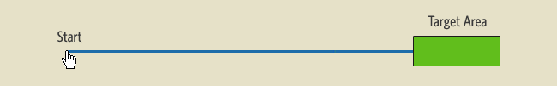
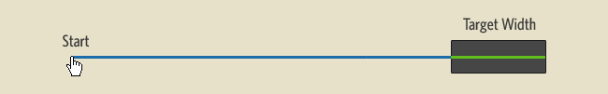
Visualizing Fitts’ law
Fitts’s Law is Made of Lines
  No
  Yes
http://particletree.com/features/visualizing-fittss-law/

Slide 7
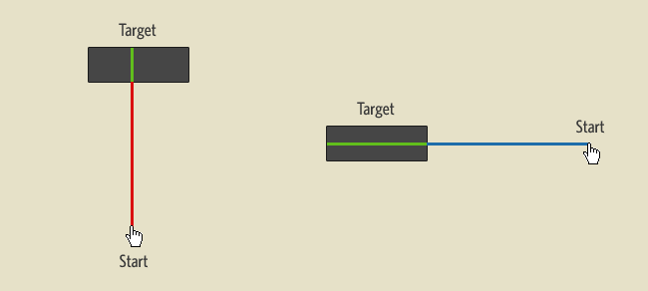
Visualizing Fitts’ law
Fitts’s Law is Made of Lines
  Which cursor will have easier time selecting the target?
http://particletree.com/features/visualizing-fittss-law/

Slide 8
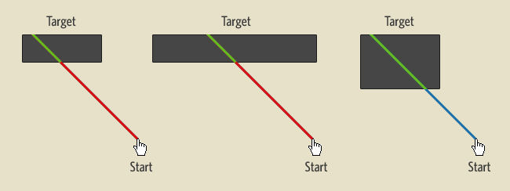
Visualizing Fitts’ law
Fitts’s Law is Made of Lines
  How to optimize the target area?
    Cursor position dependent
    Not the case with circular areas
http://particletree.com/features/visualizing-fittss-law/

Slide 9
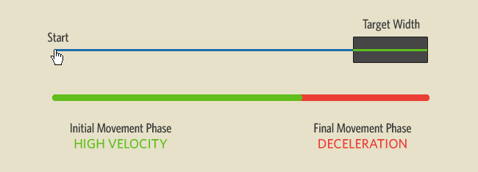
Visualizing Fitts’ law
Physical (finger) vs. Virtual Pointing (mouse)
  differences between how well we pointed at objects in real space versus objects on the computer screen (Graham and MacKenzine’96)
  “The difference between the virtual and physical display is apparent only in the second movement phase, where visual control of deceleration to the smaller targets in the virtual task took more time than in the physical task.”
  links and buttons on a screen are harder to point out with your mouse than with your finger
http://particletree.com/features/visualizing-fittss-law/

Slide 10
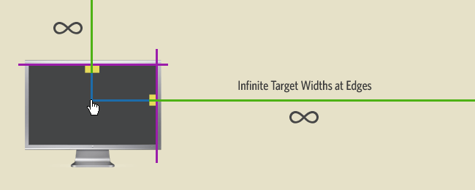
Visualizing Fitts’ law
Rule of the Infinite Edge
  For an operating system and on any full screen application, these edges are technically the most accessible
    they have infinite widths
    they also don’t require the user to have a deceleration phase (why?)
http://particletree.com/features/visualizing-fittss-law/

Slide 11
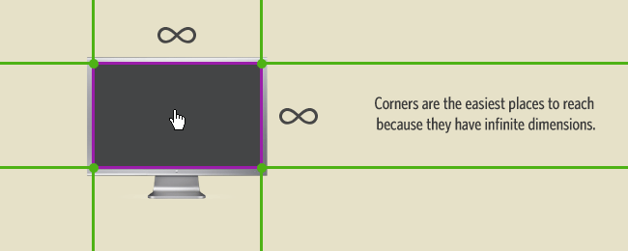
Visualizing Fitts’ law
Corners are the easiast target to reach
http://particletree.com/features/visualizing-fittss-law/

Slide 12
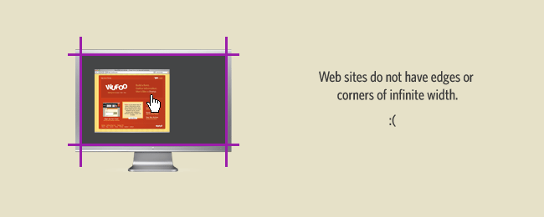
Visualizing Fitts’ law
Web applications do not get to benefit from the ‘Rule of Infinite Edges’
  They run in a browser window
  Kiosk applications could benefit
http://particletree.com/features/visualizing-fittss-law/

Slide 13
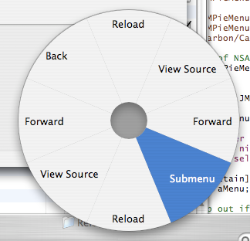
Fitts’ law: some lessons for user interface design
GUI controls should be a reasonable size
Edges and corners of the computer monitor host the Start button in Microsoft Windows and the menus and Dock of Mac OS X
  this doesn't apply to touchscreens, though
Similarly, top-of-screen menus (e.g., Mac OS) are sometimes easier to acquire than top-of-window menus (e.g., Windows OS)
Pop-up menus can usually be opened faster than pull-down menus, since the user avoids travel: the pop-up appears at the current cursor position.
Pie menu items typically are selected faster and have a lower error rate than linear menu items
  pie menu items are all the same, small distance from the centre of the menu
  their wedge-shaped target areas (which usually extend to the edge of the screen) are very large
http://en.wikipedia.org/wiki/Fitts%27s_law

Slide 14
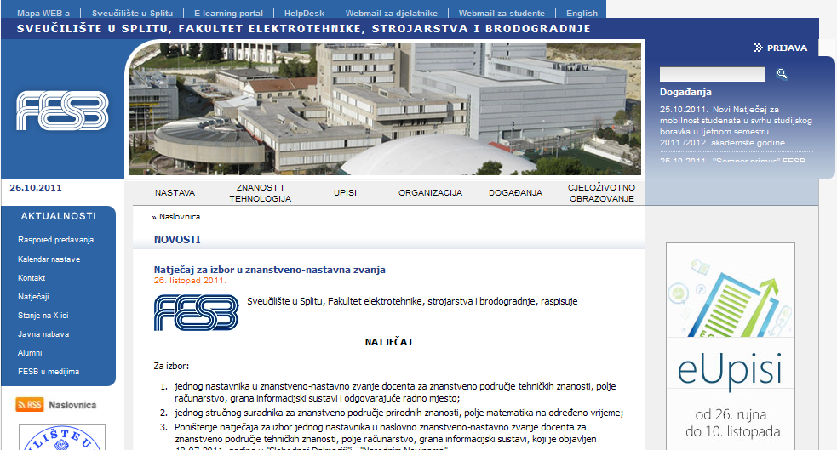
FESB web portal and Fitts’ law

Slide 15
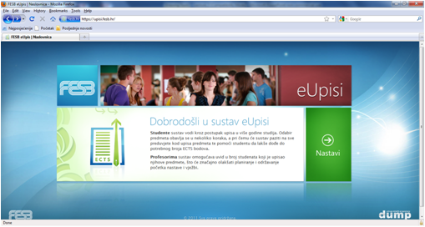
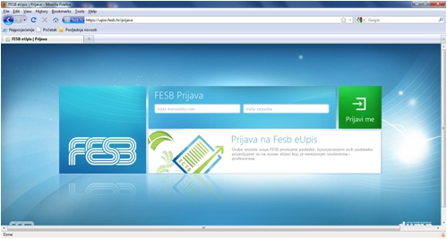
FESB: eUpisi

Slide 16
Many low-level models exist
Hick's Law
  describes the time it takes for a person to make a decision as a result of the possible choices he or she has
Memory
  long term
  working memeory (small capacity)
Power of law practice
Keystroke level model
...

Slide 17
High-level model of human-computer behavior: Norman’s 7 stages of action
Based on slides by Saul Greenberg, Russell Beale, Tolga Can,
John Hall …

Slide 18
How people do things (Donald Norman)
To get something done, you start with some notion of what is wanted – the goal to be achieved
Then you do something to the world – take action to move yourself or manipulate someone or something
Finally, you check to see that your goal was made
Human action has two primary aspects
  Execution: doing something
  Evaluation: comparison of what happened to what was desired (to our goal)

Slide 19
Norman’s action cycle
start here
Goals
What we
want to happen
Execution
Evaluation
What we do
to the world
Comparing what happened
with what we wanted to happen
THE WORLD

Slide 20
Action cycle: Stages of Execution
Goals do not state precisely what to do
  Where and how to move, what to pick up
To lead to actions, goals must be transfered into intentions
  A goal is something to be achieved
  An intention is a specific set of actions to get to the goal
    Yet even intentions are not specific enough to control actions

Slide 21
Stages of Execution - Example
“I am reading a book and decide to need more light”
  My goal: get more light
  Intention: push the switch button on the lamp
  Action sequence (still a mental event) to satisfy intention: move my body, streach to reach the switch extend my finger
  Physical execution: action sequence executed
  Note that I could satisfy my goal with other intention and action sequences
    Instead of pushing the switch, ask another person to switch on the light
    My goal hasn’t changed, but the intention and the resulting action sequence have

Slide 22
Action cycle: Stages of Execution
start here
Goals
What we
want to happen
An intention to act
so as to achieve the goal
The actual sequence of
actions that we plan to do
Evaluation
Comparing what happened
with what we wanted to happen
The physical execution
of that action sequence
THE WORLD

Slide 23
Action cycle: Stages of Evalution
Evaluation side, checking up on what happened, has three stages
  Perceiving what happened in the world
  Interpreting the state of the world
  Evaluating the outcome (against our expetations)

Slide 24
Stages of Evaluation - Example
“I am reading a book and decide to need more light”
  My goal: get more light
  Intention: push the switch button on the lamp
  Action sequence (still a mental event) to satisfy intention: move my body, streach to reach the switch extend my finger
  Physical execution: action sequence executed
  Perceive whether there is more light in room
  Decide whether the lamp turned on
  Decide whether the resulting amount of light is sufficient

Slide 25
Action cycle: Stages of Evalution
start here
Goals
What we
want to happen
Evaluation of the interpretations
with what we expected to happen
Execution
Interpreting the perception
according to our expectations
What we do
to the world
Perceiving the state
of the world
THE WORLD

Slide 26
Seven stages of action
1 for goals, 3 for execution and 3 for evaluation
  Note: only an approximate model
  Forming the goal
  Forming the intention
  Specifying an action
  Executing the action
  Perceiving the state of the world
  Interpreting the state of the world
  Evaluating the outcome

Slide 27
Seven stages of action
start here
Goals
What we
want to happen
An intention to act
so as to achieve the goal
Evaluation of the interpretations
with what we expected to happen
The actual sequence of
actions that we plan to do
Interpreting the perception
according to our expectations
The physical execution
of that action sequence
Perceiving the state
of the world
THE WORLD

Slide 28
Seven stages of action - Example
“I am reading a book and decide to need more light”
  My goal: get more light
  Intention: push the switch button on the lamp
  Action sequence (still a mental event) to satisfy intention: move my body, streach to reach the switch extend my finger
  Physical execution: action sequence executed
  Perceive whether there is more light in room
  Decide whether the lamp turned on
  Decide whether the resulting amount of light is sufficient

Slide 29
What the 7 stages model reveals
The difficulty in using everyday things and systems resides entirely in deriving the relationships between the mental intentions and interpretations (‘knowledge in the head’) and the physical actions and states (‘knowledge in the world’)
There are two gulfs that separate mental representations/states from physical components/states of the enviroment
  The gulf of execution
  The gulf of evaluation
These gulfs present major problems for users

Slide 30
What the 7 stages model reveals
The “Gulf of Execution”
  Does the system provide actions that correspond to the (mental) intentions of the person?
  Gulf of Execution: The difference between the intentions and allowable actions
  One measure of this gulf is how well the system allows the person to do the intended actions directly, without an extra effort (e.g., USB interface)
    A good system: direct mappings between intentions and selections
      printing a letter: put document on printer icon vs select print from menu
      drawing a line: move mouse on graphical display vs “draw (x1, y1, x2, y2)”
Gulf of
Execution
Physical
System
Goals

Slide 31
What the 7 stages model reveals
The “Gulf of Evaluation”
  Can feedback (percieved phyisical state) be interpreted in terms of intentions and expectations?
  Gulf of Evaluation: amount of effort exerted to interpret the feedback (physical state of the system) and to determine how well the expectations and intentions have been met
  a good system: feedback easily interpreted as task expectations
    e.g. graphical simulation of text page being printed (a form that is easy to get/see, interpret and matches the way the person thinks of the system)
  a bad system: no feedback or difficult to interpret feedback
Physical
System
Goals
Gulf of
Evaluation

Slide 32
Bridging the Gulf of Execution and Evaluation
action specifications
interface
mechanism
execution bridge
intentions
Physical
System
Goals
interpretations
interface
display
evaluations
evaluation bridge
The 7-stage structure provides a basic checklist of questions to ask to ensure that the Gulfs of Execution and Evaluation are bridged!

Slide 33
Using the 7 stages to ask design questions
How easily can a user
  determine the function of the system?
  tell what actions are possible?
  determine mapping from intention to physical movement?
  perform the action?
  tell what state the system is in?
  determining mapping from system state to interpretation?
  tell if system is in the desired state?
Goal
Execution
Evaluation

Slide 34
Using the 7 stages to ask design questions
Questions similar to principles of good design:
  Visibility
    By looking, the user can see state of application and alternatives for actions
  Good conceptual model
    Consistency in presentations of operations and results
    Coherent system image
  Good mappings
    relations between
      actions and results
      controls and their effects
      system state and what is visible
  Feedback
    full and continuous feedback about results of actions
Principle of transparency
  “the user is able to apply intellect directly to the task;
  the tool itself seems to disappear”

Slide 35

Principles of Design
1. Provide a good conceptual model.
Notes:
Allows us to predict the effects of our actions.
A conceptual model allows the user to simulate the operation of the device.
Get clues from constraints, and from the visible structure, on how a device works.
That is, find “ways of restricting the kinds of user interaction that can take place at a given moment.”
Example - scissors. The size of the holes suggests how to put your fingers in, and based on how they look, they can only be moved in one way (open and closed).
Concept of mental models is closely related
Computer examples:
A computer on its own does not have a good conceptual model – you can’t tell what it does by looking it (the only exception is that the keyboard gives clues about how to enter words, and you may be able to argue that a monitor must be for viewing things)
Gray out menu items that are currently unavailable
USB devices can only be plugged in one way
Image: http://www.abcteach.com/free/s/scissors1brgb.jpg

Slide 36
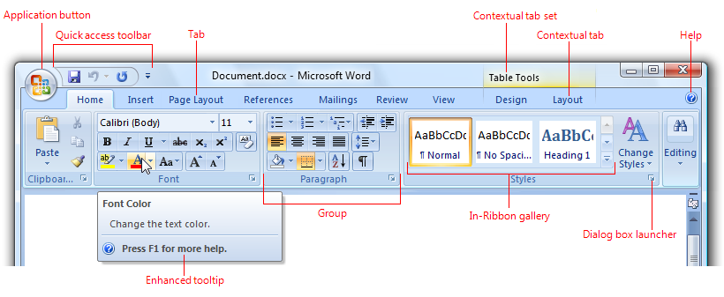
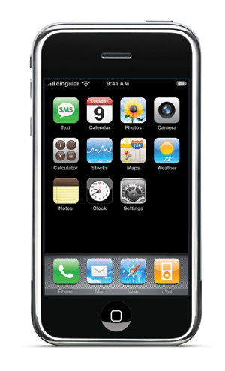
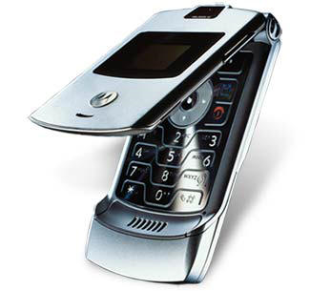
Principles of Design
2. Make things visible.
Notes:
Office phones from ten years ago (and maybe still today?) are good examples of NOT making things visible.
So many things you can do, from conference calls to transfers, etc
It’s usually not clear how to do it, and many calls are dropped as a result!
Are modern cell phones any better?
Perhaps some, like the iPhone, can make things more clear due to the complex interface
More basic phones can be really hard to use
Sensor based interaction is sometimes really hard to figure out, especially when you can’t see what to do
Ever waved your hand under a faucet for what seems like forever until you either finally get water flowing or give up and try another one?
Computer example
Don’t hide important functions in obscure menus and shortcuts (Microsoft’s ribbon feature helped improve this)
Images: http://weblogs.cltv.com/features/health/livinghealthy/cell-phones.jpg and http://www.mapds.com.au/newsletters/0807/iphone_home.gif

Slide 37
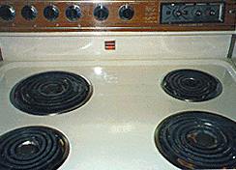

Principles of Design
3. Create natural mappings.
Notes:
Have a relationship between how controls work and what happens in the real world.
Take advantage of physical analogies and cultural standards.
E.g. To move something up, you move the control up
Computer example
Increasing a number by sliding right or turning clockwise
The garbage can on the desktop helps us create a mental model of deleting files (throwing them out)
Image: http://www.uncrate.com/men/images/2006/06/paul-frank-volume-tee.jpg

Slide 38
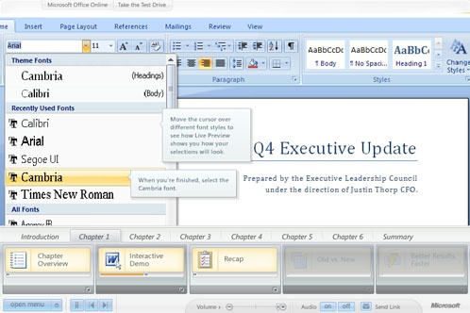
Principles of Design
4. Provide feedback.
Notes:
This means giving the user information about what action has actually been done and what result has been accomplished.
An interesting example is imagining talking to someone without being able to hear your voice, or writing without hearing/feeling the pencil on the paper
Even delays can mess up feedback – imagine playing a note on a guitar and have nothing happen for several seconds
“Feedback is about sending back information about what action has been done what has been accomplished, allowing the person to continue with the activity.”
Computer examples:
Typing on a touch screen without audio or tactile feedback is hard
Not knowing whether saving a document actually worked (show us that it did, even if it’s subtle)
Image: http://www.ivantodorov.com/blog/wp-content/070128/office5.jpg

Slide 39
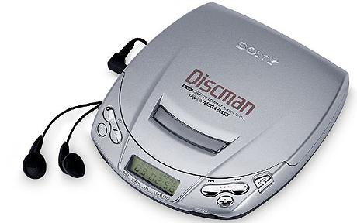
Principles of Design
5. Be consistent.
Notes:
“This refers to designing interfaces to have similar operations and use similar elements for achieving similar tasks.”
Your interface should follow some set of rules (e.g. The same operation selects various objects of different types)
Consistent interfaces are easier to learn and remember
Computer examples:
Highlighting objects and text should always use the same mouse button (say, left) – it would be inconsistent to force the user to use the right mouse button for just one kind of object
Map individual buttons to single operations in simple applications, or “create categories of commands that can be mapped into subsets of operations.”
Image: http://www.telegraph.co.uk/technology/3659992/Portable-CD-players-make-a-comeback.html

Slide 40

Principles of Design
6. Consider affordances.
Notes:
“Affordance is a term used to refer to an attribute of an object that allows people to know how to use it.”
Related to conceptual models (physical constraints), which can be used to afford (or give a clue) about how something works
Door handles afford pulling, cup handles afford grasping, etc
Computer examples:
Usually perceived affordances rather than physical (learned conventions)
When looking at an icon it should be obvious it can be clicked
Scrollbars should afford being moved up and down
Buttons should afford being pushed
Image: http://www.freshpromotions.com.au/mugs/ceramic-mugs/contrast-can-mug.html

Slide 41
You know now
Fitts’ law
  how to size and where to place your buttons and GUI menus
Norman’s stages of human interaction
  intention, selection, execution, evaluation
  problems identified as gulfs of execution and evaluation
Basic principles of good design

